Slide 1

Professional Development Library
Title: Building a Culture of Trust
Estimated Instruction Time: 30 Minutes
Publishing Date:
Learning Objectives/Topics of Instruction
Increase skills to build team cohesion
Understand the connection between trust, team culture and mission readiness
Gain an understanding of the five building blocks of a culture of trust
Notes:
Say: NA
Slide Time: NA
Notes: Slide is hidden but must remain in the Professional Development Library publications. It is built for library publication tracking and organization purposes only. The author of the brief shall provide the title and learning objectives / topics of instruction contained within the brief.
POC: Amy Ruff, R3SP 333-3804

Slide 2
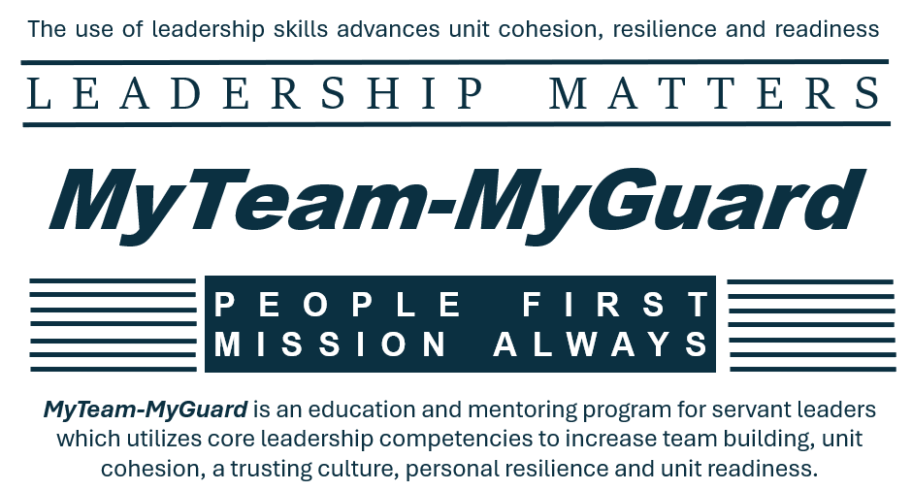
Professional Development Library
Notes:
Say: The MyTeam-MyGuard Leader Development is an action plan supported by the Social Health Work Group which is one of five work groups overseen by the NDARNG’s Commander’s Ready and Resilience Council. The objective of the action plan is to create a Professional Development Library for utilization during NCOPD/OPD periods of instruction while supporting core leadership competencies, team building, unit cohesion, trust, resilience, personal and unit readiness.
Slide Time: 30 seconds
Notes: This slide must remain in Professional Development Library publications.

Slide 3
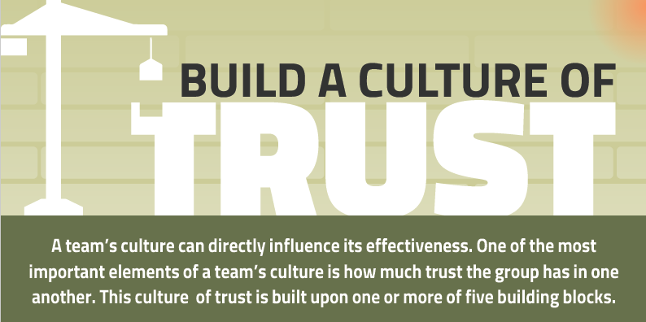
Notes:
NOTE: This slide deck is saved in “Notes Page” view. To change it, go to the top task bar, under view and toggle “Normal”.
Say: Trust is the foundation of any successful organization. In the Army, it is essential for mission success, unit cohesion and effective leadership. A strong culture of trust ensures that Soldiers operate with integrity, communicate openly and hold one another accountable to high standards. When properly cultivated, it leads to increased morale, operational efficiency and unit effectiveness.
For this period of instruction to be successful, I will rely upon all of you, to utilize active listening and engaged discussion.
Group Discussion Question- What are some characteristics of a culture of trust?
Possible Answers:
Honesty in the Army is about truthfulness in both words and actions. Leaders and Soldiers must be transparent about their capabilities, mistakes and expectations.
Trust is reinforced when leaders and subordinates can engage in difficult discussions without fear of retaliation or judgment. These conversations may involve addressing poor performance, discussing ethical concerns or providing guidance on improvement.
Accountability is a cornerstone of military discipline and operational effectiveness. Soldiers and leaders must hold themselves and others to the Army’s core values and standards. A culture where accountability is expected—not feared—ensures that mistakes become learning opportunities, rather than sources of blame.
Slide Time: 5 minutes
Notes: Utilizing facilitation skills such as summarizing, open-ended follow-on questions and showing appreciation for student contributions will help enhance this discussion heavy OPD/NCOPD.

Slide 4
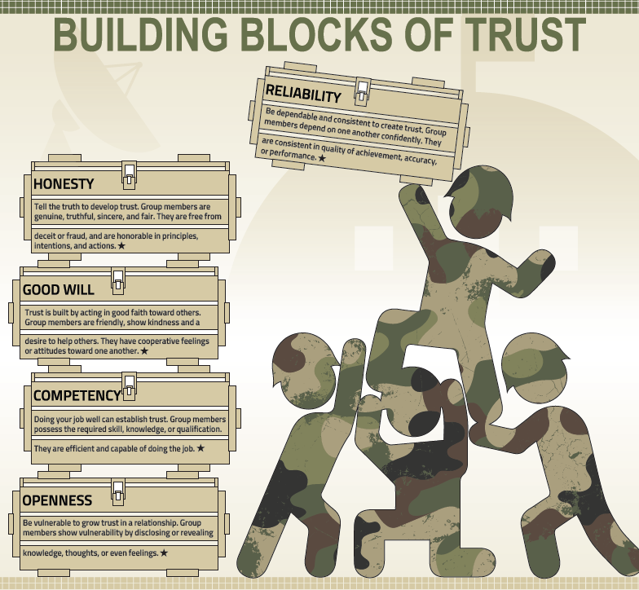
Notes:
Say: Establishing and maintaining a culture of trust requires intentional efforts through setting norms and expectations, active listening and providing performance-based feedback. The five core building blocks of trust are reliability, honesty, good will, competency and openness.
Reliability-The goal of reliability is to be dependable and consistent to create trust. Group members depend on one another confidently. They are consistent in quality of achievement, accuracy, and/or performance.
Reliability Group Discussion Question- What are some ways, you as a leader, have modeled reliability?
Possible Answers:
Setting realistic expectations
Being on time and respecting others time
Communicating proactively and working hard to keep everyone “in the loop”
Following through
Asking for help
Maintaining organization
NOTES CONTINUE….

Slide 5
This slide is intentionally left blank and hidden
Notes:
Honesty- The intent of honesty is to tell the truth to develop trust. The goal of honesty is to have group members who are genuine, truthful, sincere, and fair. They are free from deceit or fraud, and are honorable in principles, intentions, and actions.
Honestly Group Discussion Question- Think of a time when you experienced a situation when dishonesty deteriorated trust. What did you do to rebuild the team culture and/or cohesion?
Possible Answers:
Openly acknowledged the trust breach
Was as transparent as possible
Demonstrated accountability for what ever role you played
Prioritized open communication
Good Will -The intent of good will is to build trust by acting in good faith towards others. The goal of this building block is to have team members that are friendly, show kindness and have a desire to help others. They exhibit cooperative feelings or attitudes toward one another. The goal here is to assume “positive intent”.
Good Will Group Discussion Question- What role does the resilience skill of “Hunt the Good Stuff” play in the building block of good will?
Possible Answers:
HTGS is when we reflect upon a good thing that has happened by understanding why it happened, what it means to you, what you can do to get more of this good thing and how this good thing may contribute to others.
HTGS is a skill to counter act negativity bias, which is when we attend to, learn from, and use negative information more often than positive information.
HTGS is intended to build optimism which enhances the ability to show kindness and good will towards others
Competency-The intent of the competency building block, to establish trust, is simply, doing your job well. The goal of this building block is to have group members who possess the required skills, knowledge, or qualifications which allow them to be efficient and capable of doing the job.
Competency Group Discussion Question-
1-What are effective strategies to utilize when establishing, maintaining or building competency?
Possible Answers:
Highly effective communication including timely, relevant and regular instructions and feedback
Ask good questions to demonstrate knowledge and understanding
Take notes during meetings to show attention to detail
Be confident and self assured
Respect people time and use it wisely
Know your values and align your actions with them
Admit when you don’t know something and follow-up on the lack of knowledge
2- (Optional) Can an E3 and a E6 with the same MOS each be competent?
NOTES CONTINUE

Slide 6
This slide is intentionally left blank and hidden
Notes:
Openness-The intent of the openness building block is to be vulnerable to grow trust in a relationship. The goal of this building block is to have group members show vulnerability to disclosing or revealing knowledge, thoughts, or even feelings. Showing they are receptive to outside knowledge, information or others while also welcoming discussion, criticism and inquiry.
Openness Group Discussion Question- Is there a stigma in the military when it comes to showing vulnerability? If yes, how do we combat it?
Possible Answers:
Spreading the word that vulnerability is NOT A WEAKNESS. It enhances well-being and helps develop authentic emotionally intelligent leaders.
Leading by example, though sharing personal struggles. This should be done with authenticity.
Exhibiting behaviors and communication which highlight the importance of being comfortable with being uncomfortable
Challenge beliefs about expectations of being perfect in everyway or always having the right answer.
Say: Through our discussion we have gained an understanding that trust is imperative for unit effectiveness and is foundational element of team cohesion and thus mission readiness. Some strategies to increase trust in your teams include:
1. Create a psychologically safe environment. Admit when you are wrong and forgive mistakes. Respond positively to doubts and questions.
2. Recognize excellence. Appreciate when team members excel and empower future efforts.
3. Allow people to experience controlled challenges. Assign difficult but achievable tasks.
4. Encourage decision making autonomy. Give some choices or options for what to do or even how to do it.
5. Increase communication. Practice active listening. Be reflective and responsive.
6. Facilitate whole-person growth. Develop the person professionally and personally.
7. Build relationships gradually. Trust takes time and must be earned.
8. Show vulnerability. Open-up about some of your emotions, what your faults are, and don’t hesitate to ask for help.
9. Make decisions thoughtfully (based on what you believe is right). Ensure you make clear decisions, give yourself time to think, and have the courage to say “no.”
10. Be consistent. Stay true to yourself and your decisions unless the situation adjusts.
Slide Time: 20 Minutes
Notes: NA

Slide 7

Notes:
Say: To wrap up our discussion on building a culture of trust we are going to review a video produced by the Directorate of Prevention Readiness and Resilience. In four minutes, it does a nice job of summarizing what we have all been discussing.
Slide Time: 5 minutes
Notes: You will need speakers to listen to the video which is embedded, and a direct link provided below. After the video, come back to the slide deck for the remaining two slides which includes the AAR.
Culture of Trust YouTube Link
https://www.youtube.com/watch?v=jdo9tWon1Io

Slide 8
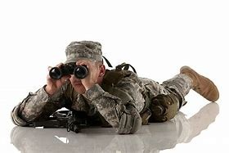
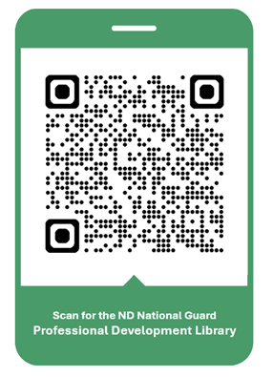
Professional Development Library
We are looking for your Professional Development Briefings!
Check out the NDNG
Professional Development Library
Submission Guidelines
(No CAC Required)
Notes:
Say: The Social Health Work Group is looking for your amazing OPD/NCOPD briefings. The submission process is outlined by scanning this QR Code. Additionally, scanning the QR code will bring you to our already published OPD/NCOPD library. We are always looking for motivated individuals to join the efforts of the Social Health Work Group. Please contact Amy Ruff, R3SP (amy.l.ruff4.civ@army.mil or 701-333-3804) if you are interested. Please bookmark or favorite this URL location for your future reference. Let's move on to our AAR.
Slide Time: 30 seconds
Notes: This slide must remain in Professional Development Library publications.

Slide 9
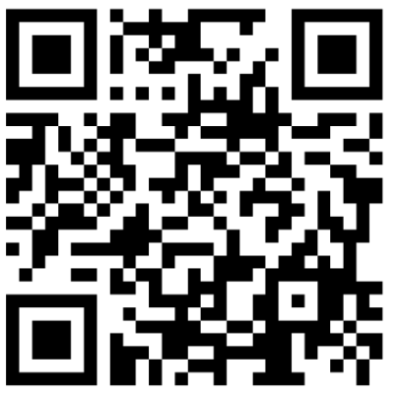
Professional Development Library
After Action Review (AAR)
Estimated Time: 2-3 Minutes
Scan for the AAR
https://forms.osi.apps.mil/r/4kDP2WDSvM
Notes:
Say: The Social Health Work Group will utilize this AAR to help improve the OPD/NCOPD course, as well as gain your ideas for future course development. It should take two to three minutes to complete.
Slide Time: 2-3 Minutes
Notes: This slide must remain in Professional Development Library publications. If the course presenter or unit leadership would like copies of the AAR results, they can contact Amy Ruff, R3SP at amy.l.ruff4.civ@army.mil or 701-333-3804.

