Slide 1

Professional Development Library
Title: Counseling 101
Estimated Instruction Time: 30 Minutes
Publishing Date: 2024
Learning Objectives/Topics of Instruction
Apply all four stages of the counseling process in the correct sequence.
Identify three approaches to counseling.
Complete all four parts of DA Form 4856 Developmental Counseling Form.
Notes:
Say: NA
Slide Time: NA
Notes: Slide is hidden but must remain in the Professional Development Library publications. It is built for library publication tracking and organization purposes only. The author of the brief shall provide the title and learning objectives / topics of instruction contained within the brief.
POC: CPT Sommerfeld and SFC Semchenko

Slide 2
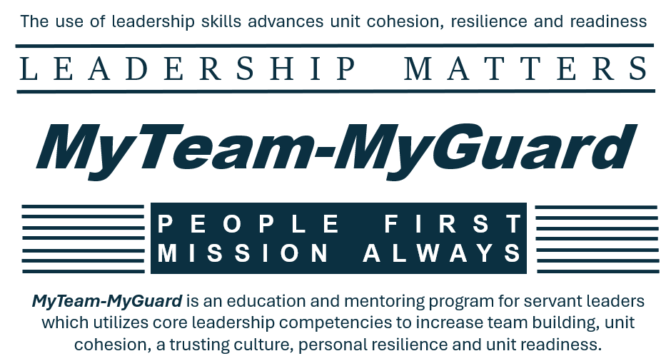
Professional Development Library
Notes:
Say: The MyTeam-MyGuard Leader Development is an action plan supported by the Social Health Work Group which is one of five work groups overseen by the NDARNG’s Commander’s Ready and Resilience Council. The objective of the action plan is to create a Professional Development Library for utilization during NCOPD/OPD periods of instruction while supporting core leadership competencies, team building, unit cohesion, trust, resilience, personal and unit readiness.
Slide Time: 30 seconds
Notes: This slide must remain in Professional Development Library publications.

Slide 3
The Counseling Process
Unit Name
Name of Instructor
Notes:
Introduce yourself and the topic you will be teaching.
Say: The counseling process is just as essential to unit's readiness as our weapons training. These skills can and should be taught at all echelons within any Army unit.
Slide Time: 30 seconds
NOTES: To remain within the anticipated 30-minute time frame, it is important to stick to the slide times as indicated, however, if you have flexibility in time feel free to extend the discussions and practical exercises.

Slide 4
Experiences with Counseling
What has been your best counseling experience?
What has been your worst counseling experience?
How do these experiences affect your ability to counsel junior Soldiers who really need it?
How could consistent counseling benefit the leader & the subordinate?
Notes:
Say: Today we will focus on the basic of the counseling process along with providing tips and tricks to improve your experiences with counseling. As we go through this information, try to keep in my some of your internal responses to the questions listed on the slide.
Ask: What has been your best counseling experience?
Ask: What has been your worst counseling experience?
Ask: How do these experiences affect your ability to counsel junior Soldiers who really need it?
Ask: How could consistent counseling benefit the leader & the subordinate?
NOTE: The above questions are rhetorical questions; acknowledge the nodding heads.
Say: Most of you have a variety of experiences to bring value you to the training today. Please keep these thoughts ready and available to discuss later as we go through the class.
Slide Time: 2 minutes

Slide 5
Terminal Learning Objective (TLO) #1
Action: Conduct the counseling process.
Conditions: As a leader, given experiential learning activities and access to references ADP 6-22, ATP 6-22.1, and AR 600-23, discussion with peers and instructor feedback.
Standard:
Be able to apply all four stages of the counseling process in the correct sequence.
Identify the three approaches to counseling.
Complete all four parts of DA Form 4856 Developmental Counseling Form.
Learning Domain: Cognitive
Level of Learning: Application
Notes:
Say: We are learning the "how to" of counseling and here are some references.
Slide Time: 30 Seconds

Slide 6
What is a counseling?
Counseling is nothing more than a conversation that has an outline and clear objective(s)
Is it more effective to simply tell someone what to do or to work with the person to develop a mutually agreed upon action plan?
Notes:
Say: No matter what the situation or reason for the counseling, leaders are attempting to improve or sustain performance.
Ask: Is it more effective to simply tell someone what to do or to work with the person to develop a mutually agreed upon action plan?
NOTE: Encourage your audience to raise their hand if they'd like to voice their opinion on the question.
Chances are someone will say, "it depends." That is a great opportunity to have them elaborate on their opinion.
Say: Counseling is performance oriented. Not positive or negative. There are many ways to get to better work, but we want to be building future leaders to create a culture of excellence throughout the Army.
Slide Time: 2 minutes

Slide 7
Four Stages of Counseling
Stage 1
Reason
*General
*Professional Growth
*Performance
*Event Oriented
Stage 2
Prepare
Suitable place
Notify Soldier
Outline
Organize
Plan strategy
atmosphere
Stage 3
Conduct
Open session
Discuss issues
Develop a plan
Document
Close session
Stage 4
Follow-up
Provide Support
Coach
Mentor
Modify
Assess
Notes:
All four Stages are necessary for effective counseling
1. Identify the Need – *General (Initial/Quarterly) *Professional Growth (CMP/EPS) *Performance (ACFT-HT/WT) *Event Oriented (Superior/Adverse)
Counseling is mandated at consistent intervals to ensure the Subordinate understands expectations. It is also important for the Soldier to understand that they are; not meeting standard, meeting standard, exceeding standard, and WHY.
2: Prepare for the Counseling
- Select a suitable place.
- Schedule the time.
- Notify the subordinate well in advance.
- Outline the counseling session components.
- Organize information and draft a plan of action.
- Plan the counseling strategy.
- Establish the right atmosphere
3. Conduct the Counseling
- The opening sets the tone for the session: if you start out joking around to break the ice and then begin a discussion that needs to be very serious the counseled Soldier may be confused (Is this sarcasms? Is this serious? Will the counselor really act if I ignore directives?)
- Be sure the Counselled Soldier can explain their point of view or understanding of the situation
- The to increase effectiveness the counselled Soldier should be “bought into the Plan”
- Capture feedback & signatures. Give one copy to Soldier and retain the original
4. Follow-up as Needed
- Support subordinate in implementing the plan.
- Provide additional time, referrals, and other appropriate resources if needed.
- Continue to teach, coach, and mentor.
- Modify the initial plan of action, if needed, to meet its goals.
- Assess the plan of action.
Part 4 is vital for long-term effectiveness. Circling back to the counseling statement lets the Soldier know that they and the topic of the Counseling is important to you the Counselor. If development of the Soldier is our goal, we will need to assess and adjust action plan
Slide Time: 2 minutes

Slide 8
Directive, Nondirective, and Combined Approaches
Counseling techniques that leaders may explore with directive, nondirective or combined approaches include:
Suggesting alternatives
Recommending
Persuading
Advising
Techniques to use during the directive approach include:
Corrective training
Commanding
Notes:
Say: Directive counselling is also called the prescriptive counselling because the counsellor prescribes the solutions or the course of action for the Soldier. Think of the directive approach as Google Maps giving you a step-by-step directions for desired destination.
Some examples/reasons for a directive approach could be: initial counseling or event oriented
Say: Non-Directive Counselling: In this type of counselling the counselee, not the counsellor is the pivot of the counselling process. Think of the non-directive approach as giving the Soldier a map and letting them discuss methods on how to get to the desired destination.
Some examples/reasons for a Non-directive approach could be: quarterly counseling or career management counseling
Say: Combined approach uses a combination: allowing the Counselee and counselor to achieve a mutual course of action.
Slide Time: 1 minute

Slide 9

Parts of DA Form 4856
Part I – Administrative Data
Part II – Background Information
Part III – Summary of the Counseling & Plan of Action
Part IV – Assessment of Plan of Action
Notes:
Ensure Participants have a blank 4856
Say: We are going to walk-though each part of the DA Form 4856. As we do that I expect you to take notes in each part. Some of these concepts may appear elementary at first glance. Again, we can make the connection here regarding how some simple techniques can improve a shot grouping with your weapon. I ask that you tune in to reflect on your techniques as a leader. You will be expected to conduct more counselings as your progress. Hopefully, this will make it easier for you in the future.
Slide Time: 1 minute

Slide 10
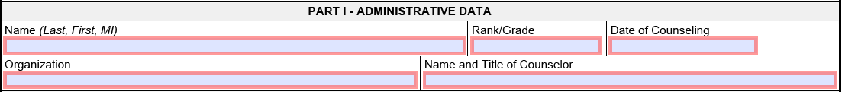
Parts of DA Form 4856
Part I – Administrative Data
Notes:
Say: Part I is the easiest. Fill in the blocks. Take into consideration you can have generic initial counseling prepared. When doing that you can leave the "Name" block empty and fill that in during the counseling session. On that note, it is a best practice that you tailor each of your counseling forms to the person you are counseling.
Slide Time: 30 Seconds

Slide 11
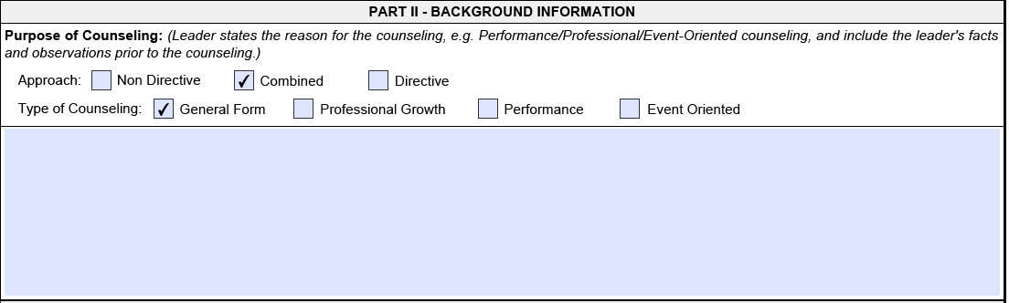
Parts of DA Form 4856
Part II – Background Information
  "New" form as of March 2023
  Clear for the "Purpose of the counseling"
Notes:
Say: Part II sets the format for how you want to outline Part III. The new form can make it easy for you to design what you want to say and how you want to say it.
TIP: If you are old school and would prefer the traditional format to the DA Form 4856, you can just click "General Form"
Ask: Take a minute to turn to the person beside you and discuss/write some of the topics that you have seen written in here.
(Give the students 1 minute)
Debrief: There are some obvious answers such as quarterly counseling, ACFT Failures, and Soldier of the month type topics. Inquire to the audience to see if they any unique topics that are not so typical, and consider them worth doing.
Slide Time: 3 minutes

Slide 12
Challenges?
What are some reasons that a counselor may find this activity awkward, uncomfortable or challenging?
What can you as the counsellor do to mitigate these concerns?
Notes:
Say: Before moving on to Part III it is important to understand some of the challenges you could face when conducting the counseling. Preparing the form with the right mindset can make the conversation easier in the moment.
Ask: What are some reasons that a counselor may find this activity awkward, uncomfortable or challenging?
Be prepared to mention any of these reasons:
Soldier has never been counseled before.
Soldier shares a doesn't respect the leader
Soldier is of the opposite sex and much younger/older than the leader
Soldier may have experienced trauma from authority figures
Ask: What can you as the counsellor do to mitigate these concerns?
Be prepared to mention any of these mitigation techniques:
Ask a mentor for advice before you prepare your counseling statements
Ask a mentor to be present
Prepare and rehearse while trying to visualize the widest variety of responses the counselled Soldier may have
Visualize how you would respond if your superior was conducting this counseling with you
Say: Remember there is no such thing as perfection. The goal of counseling is to attempting to improve or sustain performance. The best way to do that is to convey your intent and be prepared to hear the counseled Soldier's feedback to include body language.
Slide Time: 5 minutes

Slide 13

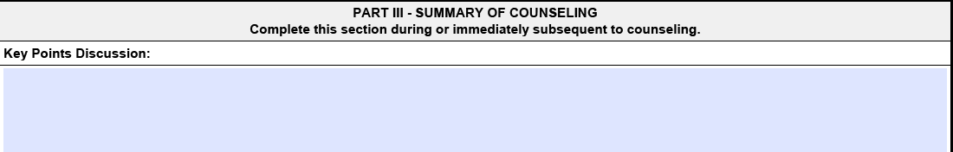
Part III – Summary of the Counseling
Outline of the counseling session
  This is where you plan out your conversation
Address the facts
  Establish indisputable results/data the basis for the counseling
Locate the “why”
  Make it productive for both people
Notes:
Say: Part III Summary of the Counseling is crucial to take it for the face value. It is a summary. It is designed to only be an outline. You do not/should not type up word by word what you want to say. Also, on the other extreme, you should not do one word bullets to prompt you into what you want to discuss.
Say: This is the area you want to establish a common understanding for facts, expectations regarding performance, or even write up some questions here. If you do the question suggestion, make sure to leave room for any notes you might want to take so you have it all on one form.
Say: In Part II you wrote up the "purpose of the counseling." That is different than what you are doing in Part III. Here is the place where you have the discussion regarding, "why do the facts/performances happen at all?" Good or bad, you can be intentional about locating the why and growing that professional relationship to produce more desired outcomes. Try to find: Why the Counselee did a something? What was the thought process? Is there a pattern?
Slide Time: 2 minutes

Slide 14
Part III – Plan of Action
Find motivation
  Internal VS External motivators
Reach for maximum effectiveness
  Every Soldier reacts differently to criticism
Notes:
Say: Part III Plan of Action is tough to do ahead of time in some cases, but it is very important to the process to set fourth expectations. It is one thing to have a conversation about growth, but it is another more important thing to walk away knowing that you have been given measurable expectations when that conversation is done.
Say: You want to attempt to tie Soldiers individual motivation to the desired performance objective. Give some insight to the audience about motivators:
internal motivators: pride, curiosity, independence, satisfaction
external motivators: promotion, awards, recognition
Ask: Take 2 minutes to turn to the person beside you and discuss/write some of the expectations you could put in the plan of action for a quarterly counseling.
(Give the students 2 minutes)
Debrief: Inquire to the audience to see if they'd like to share their ideas. It is important to keep an open mind with this one. It can be very unit/rank dependent.
Some examples that you could share as an instructor to list for the class could include:
"Fill out Support Form and/or Career Management Plan with a NLT date"
"Read a book on tactics, leadership, or MOS related skills"
"Attend/teach some form of Professional Development outside normal duty hours"
"Send me your initial counseling that you plan on using for your subordinates"
Say: Whatever you decide ahead of sitting down to discuss the DA Form 4856 with the Soldier, be prepared that you plan of action may change. Remain flexible, but show up prepared with some ideas to make the conversation productive. You are not sure how overwhelmed or underwhelmed the Soldier may feel regarding the conversation you are having.
Slide Time: 5 minutes

Slide 15
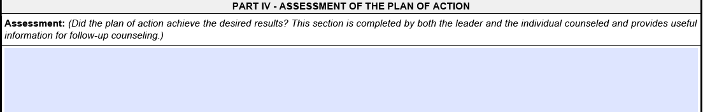
Part IV – Assessment of Plan of Action
Schedule/outline the assessment in Part III
Express praise/concerns
  Quantify results as much as possible
  Provide clear guidance to sustain or improve outcomes
Notes:
Say: The manner on how/when the leader will be assessing performance needs to be communicated to the greatest extent during Part III. People want to feel as though they were treated fairly and given a chance to succeed. Depending on the purpose of your counseling this assessment does not have to include much information. It is still a very important part as it can set the stage for more important conversations that could occur in the future.
Say: Take a moment to look back at your Part III Plan of Action notes. You should be able to accurately provide feedback on each of those possible actions. If you cannot, it likely belongs in the Part III Summary of Counseling.
Say: Part IV Plan of Action is the most commonly missed portion of the form. It is more-likely for Soldiers to follow through with the Plan of Action when they know their leaders will actually assess that plan.
Slide Time: 1 minute

Slide 16

Tips and Tricks
Do not recreate the wheel
  Find resources online - www.armywriter.com/ncoer.htm
  Ask a leader or people who have been in your position
Timeliness matters
  Routines create habits that lead to building relationships
  Recent actions/behaviors should be the focus
Soldier care is top priority
  Bring in a third non-bias Soldier
  Transparency goes a long way
Notes:
*Feel free to insert additional tips that you have learned in your experience*
Say: Here a few tips and tricks that can make the counseling process less intimidating and more along the lines of the Army's intent behind the DA Form 4856.
When starting from scratch, you can ask for help. Ask Google, Ask your leaders, or a person who has been in your position. Chances are someone, somewhere, and some point in time had the same questions or concerns you had. You might be surprised the resounding support you'd get by asking leaders within the organization (even if they are complete strangers) for help with preparing a counseling session.
Extra note: One of the greatest outcomes from doing consistent counseling documents show up when you go to write an NCOER /OER and all your 4856s have bullets that can inspire an accurate evaluation. The evaluation, good or bad, should not be a surprise especially because you had the conversations with the Soldier.
Timelines are very important to creating healthy and reasonable counseling sessions. Everyone knows the obvious that in the event of a DUI, ACFT failure, or other circumstances of negative counseling the situation needs to be addressed as soon as possible. Well, what we tend to forget is that we can be intentional with our time to conduct productive/relationship based counseling sessions too.
When we put the Soldier's needs first it can go a long way in the counseling process. Leaders need to be aware if the Soldier feels uncomfortable or they cannot trust leadership. Counter-measures can be taken to correct that, but it is going to require time and transparency to re-establish a level of care that leaders can use to leverage the Soldier's internal motivators.
Ask: Does anybody else have any tips and tricks that you have learned over the years?
Debrief: Respond and acknowledge any answers. Transition to the last slide to conclude the training.
Slide Time: 3 minutes

Slide 17
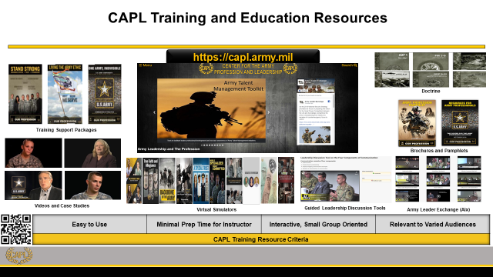
CAPL Training and Education Resources
Notes:
Say: Last, but not least, we will finish with this plug to get more resources and materials for the Army leader development programs. Check out Center for Army Leadership, and you'll be surprised at how much stuff is out there for you to use.
Slide Time: 1 minute

Slide 18


Professional Development Library
We are looking for your Professional Development Briefings!
Check out the NDNG
Professional Development Library
Submission Guidelines
(No CAC Required)
Notes:
Say: The Social Health Work Group is looking for your amazing OPD/NCOPD briefings. The submission process is outlined by scanning this QR Code. Additionally, scanning the QR code will bring you to our already published OPD/NCOPD library. We are always looking for motivated individuals to join the efforts of the Social Health Work Group. Please contact Amy Ruff, R3SP (amy.l.ruff4.civ@army.mil or 701-333-3804) if you are interested. Please bookmark or favorite this URL location for your future reference. Let's move on to our AAR.
Slide Time: 30 seconds
Notes: This slide must remain in Professional Development Library publications.

Slide 19
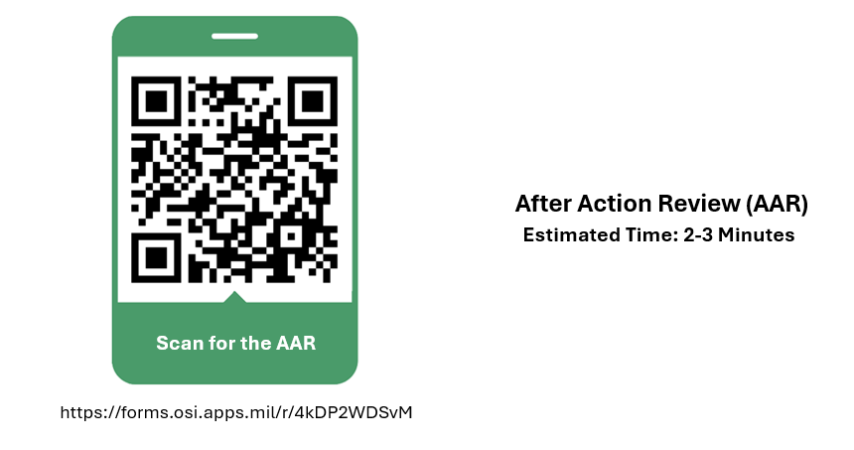
Professional Development Library
Notes:
Say: The Social Health Work Group will utilize this AAR to help improve the OPD/NCOPD course, as well as gain your ideas for future course development. It should take two to three minutes to complete.
Slide Time: 2-3 Minutes
Notes: This slide must remain in Professional Development Library publications. If the course presenter or unit leadership would like copies of the AAR results, they can contact Amy Ruff, R3SP at amy.l.ruff4.civ@army.mil or 701-333-3804.

