Slide 1

Professional Development Library
Title: Facilitation Skills: The Big 6
Estimated Instruction Time: 30 Minutes
Publishing Date: 2024
Learning Objectives/Topics of Instruction
Improve skill and confidence in delivering Army instruction using facilitation techniques that support adult learning.
Demonstrate the effective use of facilitation strategies.
Notes:
Say: NA
Slide Time: NA
Notes: Slide is hidden but must remain in the Professional Development Library publications. It is built for library publication tracking and organization purposes only. The author of the brief shall provide the title and learning objectives / topics of instruction contained within the brief.
POC: Amy Ruff, R3SP

Slide 2
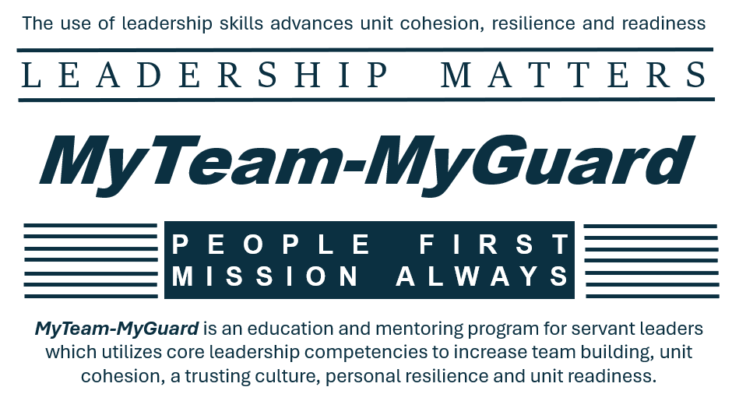
Professional Development Library
Notes:
Say: The MyTeam-MyGuard Leader Development is an action plan supported by the Social Health Work Group which is one of five work groups overseen by the NDARNG’s Commander’s Ready and Resilience Council. The objective of the action plan is to create a Professional Development Library for utilization during NCOPD/OPD periods of instruction while supporting core leadership competencies, team building, unit cohesion, trust, resilience, personal and unit readiness.
Slide Time: 30 seconds
Notes: This slide must remain in Professional Development Library publications.

Slide 3
MyTeam-MyGuard
People First Mission Always
Social Health Work Group
Facilitation Strategies
Facilitation Skills: The Big Six
LEARNING OBJECTIVE
Action
Improve skill and confidence in delivering Army instruction using facilitation techniques that support adult learning.
Standard
Demonstrate the effective use of facilitation strategies.
Notes:
Say: Today we will focus on tips and tricks to improve your facilitation skills which are also known as instruction skills, briefing skills or trainer skills.
Ask: Have you ever attended a drill weekend and been handed a paper copy of a slide deck, with no notes, 50 slides, on a topic you are not familiar and told you are going to provide this training to the entire unit by the end of day?
NOTE: The above question is rhetorical question; acknowledge the nodding heads.
Say: The skills we are going to review will be applicable to any briefing, training or course you are providing. They will help you feel more comfortable in your role and help your students or audience be more engaged in your instruction. It is my intent that you improve your skills and confidence when delivering instruction.
Slide Time: 1 minute

Slide 4

MyTeam-MyGuard
People First Mission Always
Social Health Work Group
Facilitation Strategies
Bridging
Think-Pair-Share
Asking Quality Questions
Efficient Instructions
Conducting Effective Discussions
Handling Challenges Effectively
CUI
Notes:
Say: Here’s a quick look at the big six facilitation strategies that we’ll be discussing during this lesson. These strategies may look very familiar to you, or you may know them by some other name. Either way, we believe your training and confidence will benefit from practicing the use of these facilitation strategies. This will be a very interactive lesson, so remain focused and be prepared for practical exercises.
Slide Time: 30 Seconds

Slide 5

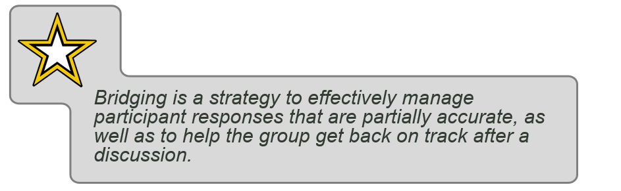
MyTeam-MyGuard
People First Mission Always
Social Health Work Group
#1 Bridging
Use bridging to:
  Filter and highlight what is right or relevant about what the participant stated.
  Identify the portion of the response you want to reinforce and use that to move the conversation along.
CUI
Notes:
Say: Let’s begin with bridging. It is the trainer’s job to guide the training to ensure the group stays on track regarding both timing and content. Bridging is a strategy to effectively manage participant responses that are partially accurate as well as help the group get back on track after a discussion.
Say: Participants may unknowingly provide responses or contributions that do not align with where the training is headed. Use bridging to link the part of the student’s contribution that is on target back to the main point of the training. If a contribution is completely wrong or misleading, it is always important to correct that information in the moment, so participants do not learn incorrect information. This should be done in a tactful way that does not shut down participants.
Say: However, if the point is not entirely wrong or the group gets off track, the facilitator should identify and capitalize on a useful phrase or main point that was stated and make a connecting summary statement or connect it with a new question that can move the discussion forward.
Slide Time: 1 minutes

Slide 6
MyTeam-MyGuard
People First Mission Always
Social Health Work Group
Practical Exercise: Bridging
#1
BRIDGING
Scenario
You are facilitating a suicide prevention training, and the group is having a discussion on stigma prevention. A participant starts telling a story about someone he knows who sought help and it ended her career. You see lots of heads nodding and other participants start jumping in to tell their stories.
How can you use bridging to regain control of the conversation in a way that doesn’t shut down participants?
What are some statements you could make to tie what is being said to the topic at hand?
What other statements could you make to move the conversation forward?
CUI
Notes:
Say: Throughout our time today we will be utilizing scenario based practical exercises. Can I get a volunteer to read the scenario?
Say: I want each of you to pretend you are the facilitator of this training and as a large group we will discuss the three questions on the screen. I will always lead by example so how I would manage the scenario is by responding, “The Army has struggled with stigma for sure. More and more though we see the messaging is changing, like how we’re talking about it now in this training and making connections to fight it.”
Say: So, what are some of your examples of using bridging to get control of the conversation, or tying the conversation at hand to the topic of stigma prevention and statements you could make as the facilitator to move the conversation forward?
NOTES: Utilize affirmations, summaries and paraphrasing to recognize student participation.
Slide Time: 3 minutes

Slide 7
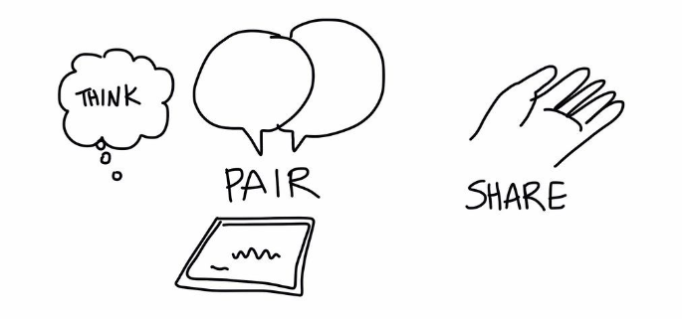
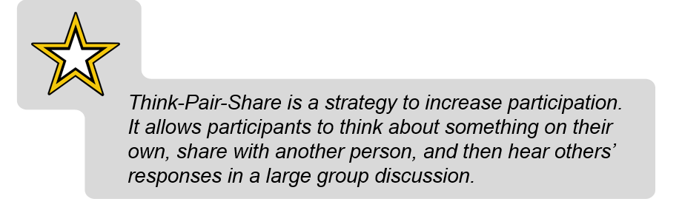
MyTeam-MyGuard
People First Mission Always
Social Health Work Group
#2 Think-Pair-Share
Some benefits:
  Engages everyone even if they don’t share with the large group.
  Gives participants time to think about their responses before contributing to the large group discussion.
  Can help people feel more comfortable sharing their ideas.
CUI
Notes:
Say: The next strategy we’ll talk about is the Think-Pair-Share; which is a form of informal group learning that is a low-risk and high-impact strategy to increase participation. It allows participants to think about something on their own, share with another person, and then hear others’ responses in a large group discussion.
Say: Think-Pair-Share is initiated by posing a question or providing a scenario. The students are then asked to think about the question or scenario and optionally write a brief response. Next, have participants pair up and discuss their response with one another. Lastly, when the large group reconvenes, ask individuals to report back on their conversation, sharing what they said or alternatively, what their partner said.
Say: Keep in mind that the Think-Pair-Share strategy can be time consuming so make sure you plan when and where you intend to use it.
Slide Time: 1 minutes

Slide 8
MyTeam-MyGuard
People First Mission Always
Social Health Work Group
Practical Exercise: Think-Pair-Share
#2
THINK
PAIR-SHARE
Scenario
Think about a recent briefing or training that you would describe as awful; with low facilitator engagement and you leaving the training more confused then when you arrived.
Think, then come together in small groups and discuss the below.
(Please leave out names of individual facilitators)
Identify at east one potential topic/activity within the training where the facilitator could have implemented think-pair-share.
Why do you think it would have been beneficial to use think-pair-share?
CUI
Notes:
Say: Its time for our practical exercise. I’m going to give you about one minute to think, on your own, about a recent training experience that you would rate a 0 on a scale of 0-10. This training experience could have been awful for many reasons but one of the reasons was a lack of facilitator engagement and participant interaction. Then I would like you to break down into small teams for two minutes for discussion. Finally, we will come back together as a larger group to get responses. Remember, we are not here to “roast” any one so leave out the names of facilitators when you are discussing your previous experiences.
NOTE: Warn the small groups when they have one minute left; then 30 seconds left.
Say: Who has an example of when including think-pair-share would have resulted in an improved training experience and why would it have been beneficial?
Slide Time: 4 minutes

Slide 9
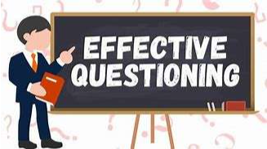
MyTeam-MyGuard
People First Mission Always
Social Health Work Group
#3 Asking Quality Questions
Asking quality questions is important for generating participation and group discussions.
Ask quality questions by:
  Using closed-ended questions for a check on learning or to get a group consensus.
  Using open-ended questions to generate discussion.
  Restating your question when it seems unclear.
  Polling the audience to get a show of hands, then asking the participants to provide examples or explain their rationale.
  Letting the participants know, when appropriate, if there is “no right or wrong answer for this question,” which can ease the pressure on the group.
CUI
Notes:
Say: A well thought-out question takes planning and even the best questions may not resonate with a particular group so it’s also important to build the skill of restating questions.
Say: Overall, question asking starts with backward planning, being clear about what answer (or types of answers) you want to elicit from the group.
Say: You can use different methods of questioning based on what you’re trying to achieve in the moment. For example, utilizing closed and opened questions each provide a different end state, or a simple restatement of your question provides clarity and time for participants to respond.
Say: Your next activity is designed to help you develop some quality questions as part of a practical exercise.
Slide Time: 1 Minute

Slide 10
MyTeam-MyGuard
People First Mission Always
Social Health Work Group
Practical Exercise: Asking Quality Questions
#3
Quality Questions
Scenario
You have been asked to provide instruction to your unit on a new Army Regulation which requires all Soldiers in the Army Band to grow their hair out to achieve the “80’s Hair Band” look. The briefing includes requirements on the type hair spray to be utilized and images depicting the most efficient styling processes to achieve the desire end state.
Identify an open-ended question to generate discussion within the briefing.
Create 1 learning objective you want your students to achieve.
Backwards plan a close ended question to ensure your audience has achieved the learning objective.
CUI
Notes:
Say: This scenario states, “You have been asked to provide instruction to your unit on a new Army Regulation which requires all Soldiers in the Army Band to grow their hair out to achieve the “80’s Hair Band” look. The briefing includes requirements on the type hair spray to be utilized and images depicting the most efficient styling processes to achieve the desire end state.”
Say: For this practical exercise we are going to focus on being intentional with the types of questions we engage our audience with through backwards planning.
Say: Based upon this scenario, I would like you to develop at least one open ended question meant to generate discussion with your students about the new Army Regulation. For example, my open question would be, “What do you believe would be the benefit to the Army Band’s mission to have an 80’s Hair Band look?”
Say: Then I want you to create a learning objective based upon the scenario, for example, my learning objective would be, “Soldier’s will gain an understanding of the exact angle a military issued hairbrush must be at when utilizing the hair drier to create maximum volume.”
Say: Finally, I would like to you backwards plan a closed ended question to ensure the audience has met the learning objective. To continue with my example this would be “Yes or No, the regulation requires Soldiers to hold their military issued hairbrush at a 25-degree angel to achieve maximum volume when drying their hair.”
Say: Please utilize the next 2 minutes to individually complete the three tasks listed on the slide. Then I will be asking for volunteers to share their responses.
NOTE: Provide a one minute and then 30 second warning.
Say: Who would like to provide an example of their open-ended question, learning objective and closed ended question?
Slide Time: 4 minutes

Slide 11
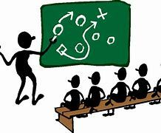
MyTeam-MyGuard
People First Mission Always
Social Health Work Group
#4 Efficient Instructions
Efficient instructions for exercises are clear and concise directions resulting in participants’ understanding of the intent of the exercise, what actions they need to take, and how long they have to complete the work.
Include timings in your instructions that helps participants understand how in-depth their discussions should be.
  Provide time prompts such as “1 minute left” to keep the group on track during activities.
Demonstrate lengthy instructions by role playing with another individual.
  This approach is more engaging than verbally reciting directions.
  End with exactly what students need to do to get started (instruction #1).
CUI
Notes:
Say: To create efficiency within a training or briefing ensure your instructions are clear and concise. Providing in-depth instruction on the steps they need to take and how long they have to complete the assigned task.
Say: Providing time prompts such as ”1 minute left”, “30 seconds left”, or “start wrapping up your discussion” keeps the group on time and task,. Additionally, it is beneficial when providing complex instructions, that the last piece of information to the group should be the first thing they will start on and can be further explained through role play with another individual.
Say: Taking a little bit of extra time in being clear and concise will save you time in the long run avoiding follow-up questions and will result in participants having a clear understanding of the intent of the exercise resulting in an increased likelihood of learning.
Slide Time: 1 minute

Slide 12
MyTeam-MyGuard
People First Mission Always
Social Health Work Group
Practical Exercise: Efficient Instructions
#4
Efficient Instructions
Scenario
You have been asked to provide a briefing to your unit on required completion of the Azimuth (formally known as GAT). You want the entire class to break down into teams of 3-5 PAX, complete the 4 discussion questions provided to them and elect a team leader who will provide a summary of the small group responses to the larger group. You have allowed 5 minutes for small group discussion.
Practice providing efficient instructions based upon the scenario description.
Be prepared to discuss what went well and what you would like to improve upon.
CUI
Notes:
Say: Can I get someone to read the scenario for the efficient instruction exercise?
Say: I want you to beak into teams of two; with each of you practicing providing efficient instructions based upon the scenario description. You have 3 minutes to complete this exercise and I will provide you with a 1 minute and a 30 second warning. When we come back together as a larger group be prepared to discuss your level of comfort in performing the skill of efficient instructions; go ahead and break into teams of two and start practicing providing efficient instructions.
NOTE: Provide a one minute and then 30 second warning.
Say: So, what went well and what would you like to do better on next time?
Slide Time: 4 minutes

Slide 13

MyTeam-MyGuard
People First Mission Always
Social Health Work Group
#5 Conducting Effective Discussions
Discussions can sometimes get off track. It is important to be purposeful when leading a conversation about a particular topic or activity.
Elements of an Effective Discussion:
Learner-centric
Keep the conversation moving
Summarize the discussion
CUI
Notes:
Say: Discussions and exercises can sometimes get off track. It’s important to be purposeful when leading discussions about a particular topic or activity.
Say: Debriefing is an opportunity for participants to reinforce learning objectives and key points. In fact, adults learn better by drawing their own conclusions based on their own experiences rather than just being told what they are supposed to learn. The facilitator should ask questions to elicit these learning objectives and debriefs should always include clear take-aways.
Say: Effective discussions keep the conversation moving, and help the facilitator recognize when to shift to another related topic or expand the conversation. For example, “We’ve spent a couple of minutes talking about the benefits of the Army Band growing their hair out to meet the new Army Regulation. Does anyone in the room have some tips or tricks to assist the Soldiers in meeting the hair length standard in shortest amount of time?”
Say: Effective discussions should include a summary and key take-away points. For example, “So what I heard was only shampooing two times per week, reducing the amount of time they wear a baseball hat, and the use of collagen vitamins could all boost hair growth, thank you for your responses I might even try that collagen tip.”
Slide Time: 1 minute

Slide 14
MyTeam-MyGuard
People First Mission Always
Social Health Work Group
Practical Exercise: Conducting Effective Discussions
#5
Conducting Effective Discussion
Scenario
You are facilitating a safety brief which is inclusive of demonstrating the Army’s 22 required steps for opening a door.
As the facilitator of the safety brief, you are just about to start large group discussion, including AAR comments, on the practical demonstration of the 22 steps.
Independently identify 2 opening questions you could ask to start the discussion (not a small group exercise).
Be prepared to discuss your questions.
Why you chose the questions you did.
What responses were you hoping to illicit because of asking the questions you developed.
CUI
Notes:
Say: Now it is time for you to practice, in this scenario you are facilitating a safety brief which is inclusive of demonstrating the Army’s 22 required steps for opening a door. As the facilitator of the safety brief, you are just about to start large group discussion, including AAR comments, on the practical demonstration of the 22 steps.
Say: Here is an opportunity to practice planning open ended questions with a clear intent in mind to conduct an effective discussion. Based upon the scenario, independently identify, this is not a small group activity, 2 opening questions you could ask to start the discussion. I will give you 2 minutes to complete this activity.
NOTE: Provide a one minute and then 30 second warning.
Say: Let’s hear some of your questions, why you chose them and some possible responses the questions might generate.
NOTES: Utilize affirmations, summaries and paraphrasing to recognize student participation.
Slide Time: 4 minutes

Slide 15

MyTeam-MyGuard
People First Mission Always
Social Health Work Group
#6 Handling Challenges Effectively
There can be many challenges that occur when teaching a class. Having strategies in handling challenges that are likely to arise can help you be more prepared.
Handling difficult questions:
Prompt the group to brainstorm ideas.
It’s okay to say you don’t know; make sure to follow up later.
Managing challenging participants (quiet, confrontational, oversharing):
Encourage strategies such as Think-Pair-Share and the parking lot.
Establish ground rules to manage expectations and protect privacy.
Acknowledge the response but ask for others’ responses.
CUI
Notes:
Say: You are not expected to know everything, but as a facilitator, you do want to ensure there are no big loose ends or questions left unaddressed. Likewise, some participants may be very open about sharing their experiences and may not pick up on subtle cues that they may be sharing too much. During these situations, other participants may get frustrated and/or start to shut down, which is why it is important to have some strategies on how to handle situations such as these.
Say: Let’s talk about handling difficult questions. One thing you can do, is to ask the group for their thoughts or ideas. It may be that someone in the group has had a similar experience or expertise in the subject area.
Say: In the case that participants are being quiet. It’s important to manage your impulse to make something happen. Practice being okay with silence. The audience may be thinking about what they want to say and by jumping in, you may inadvertently shut down the conversation.
Say: In the case of oversharing or being confrontational, use empathy and do your best to preserve the dignity of the person. Respect their opinions while ensuring they do not interfere with training. Remind them of the class rules for privacy and protection. For example, I could politely interrupt by saying, “That’s an interesting point. Let’s see what others may think.”
Say: You can also use the parking lot strategy. The parking lot strategy is a “place” to park questions or topics that may not be useful to discuss at that time in the training. Return to them later in the training as necessary.
Slide Time: 2 minute

Slide 16
MyTeam-MyGuard
People First Mission Always
Social Health Work Group
Practical Exercise: Handling Challenges Effectively
Scenario
SGT Snuffy is facilitating an annual brief on the three steps of Ask, Care, Escort (ACE) Suicide Prevention. Unknown to SGT Snuffy, one of the Soldier students is a is a trained clinical counselor. This Soldier has dominated the group discussion, provided clinical diagnosis, therapeutic techniques, and personal stories resulting in a much deeper dive into mental health treatment then the ACE learning objectives called for; and the 30-minute brief has been turned into an hour.
#6
Handling Challenges Effectively
Break into small teams to identify how SGT Snuffy could more effectively manage the challenges presented above, thus resulting in:
  Meeting the learning objectives of ACE.
  Staying within identified time frames.
Be prepared to discuss your brainstorming ideas with the larger group.
CUI
Notes:
Say: Now it is time for you to practice, can I get a volunteer to read the scenario on the screen?
Say: Utilize think-pair-share by breaking down into small teams and discussing how bridging, think-pair-share; asking quality questions, efficient instructions and conducting effective discussions could have been used by SGT Snuffy to meet the learning objectives of ACE and remain within time limitations. I am going to give you three minutes and then we will come back together to discuss as a larger group.
NOTE: Provide a one minute and then 30 second warning.
Say: Can I get some volunteers who are willing to provide some advise to SGT Snuffy?
NOTES: Utilize affirmations, summaries and paraphrasing to recognize student participation.
Slide Time: 5 minutes

Slide 17

Optional Slide
MyTeam-MyGuard
People First Mission Always
Social Health Work Group
Bridging
Think-Pair-Share
Asking Quality Questions
Efficient Instructions
Conducting Effective Discussions
Handling Challenges Effectively
CTRL + Click
LET’S PUT THE PIECES TOGETHER
CUI
Notes:
NOTES: If time allows play video and have students take notes on how Michael Scott from The Office could have utilized the Facilitators Skills just trained on. Video has sound and can be found at : Michael Scott Sensitivity Training - The Office

Slide 18
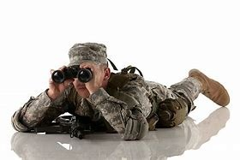
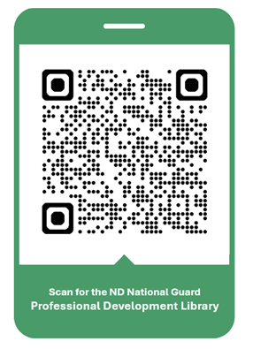
Professional Development Library
We are looking for your Professional Development Briefings!
Check out the NDNG
Professional Development Library
Submission Guidelines
(No CAC Required)
Notes:
Say: The Social Health Work Group is looking for your amazing OPD/NCOPD briefings. The submission process is outlined by scanning this QR Code. Additionally, scanning the QR code will bring you to our already published OPD/NCOPD library. We are always looking for motivated individuals to join the efforts of the Social Health Work Group. Please contact Amy Ruff, R3SP (amy.l.ruff4.civ@army.mil or 701-333-3804) if you are interested. Please bookmark or favorite this URL location for your future reference. Let's move on to our AAR.
Slide Time: 30 seconds
Notes: This slide must remain in Professional Development Library publications.

Slide 19

Professional Development Library
After Action Review (AAR)
Estimated Time: 2-3 Minutes
Scan for the AAR
https://forms.osi.apps.mil/r/4kDP2WDSvM
Notes:
Say: The Social Health Work Group will utilize this AAR to help improve the OPD/NCOPD course, as well as gain your ideas for future course development. It should take two to three minutes to complete.
Slide Time: 2-3 Minutes
Notes: This slide must remain in Professional Development Library publications. If the course presenter or unit leadership would like copies of the AAR results, they can contact Amy Ruff, R3SP at amy.l.ruff4.civ@army.mil or 701-333-3804.

