Slide 1
Title: Leave and Earning Statement
Estimated Instruction Time: 30 Minuets
Publishing Date: 20250305
Learning Objectives/Topics of Instruction
1. How to find your LES.
2. How to read your LES.
3. How to find discrepancies in your LES and how to fix it.
Notes:
Original presentation author SGT Amber Hunsaker
Published 7AUG25

Slide 2


Professional Development Library
Notes:
Say: The MyTeam-MyGuard Leader Development is an action plan supported by the Social Health Work Group which is one of five work groups overseen by the NDARNG’s Commander’s Ready and Resilience Council. The objective of the action plan is to create a Professional Development Library for utilization during NCOPD/OPD periods of instruction while supporting core leadership competencies, team building, unit cohesion, trust, resilience, personal and unit readiness.
Slide Time: 30 seconds
Notes: This slide must remain in Professional Development Library publications.

Slide 3
Leave and Earning Statement
Unit Name
Name of Instructor
Notes:
Introduce yourself and the topic you will be teaching.
Say: Knowing where to find, read, and understand your LES will help all Soldiers at every level.
Slide Time: 30 Seconds
Notes: To stay within the anticipated 30 minuets time frame, stick to the slide notes and times. Be aware there may be many questions asked throughout the brief. If you have more than 30 minuets of time, feel free to encourage discussion and go more in-depth in the questions being asked.

Slide 4
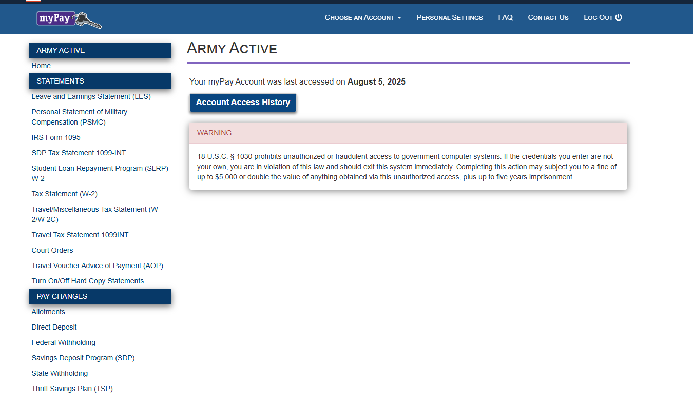
To get to your LES you will click on the leave and earning statement on the left-hand side.
Make sure if you are Tech that you are looking at the correct account.
To do this click on the Choose an account option on the top middle of your screen.
You will be able to look at your tech side and your drill side.
Notes:
You can always come back to this slide to reference where to click on the home screen.
Q: Why do Techs have two accounts.
A: they get paid on the tech side for their job and they get paid for drill. These two paychecks come from different pots of money and so they get two LESs for each paycheck. That is why they need two accounts.

Slide 5
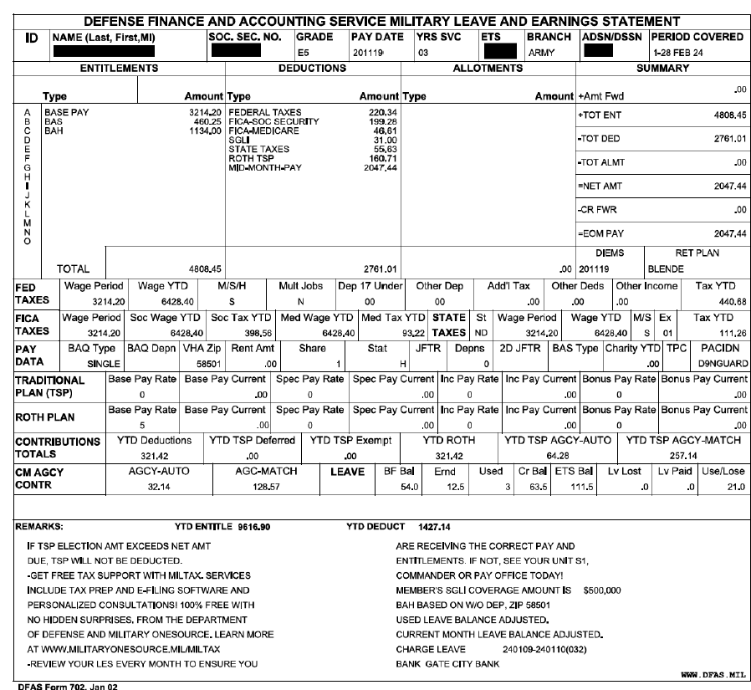
This is your LES. It is important that you are always checking your My Pay account when you get paid for drill.
Notes:
This is what it should look like when you pull your LES from My Pay. This will cover one pay period. AGR LESs now will look a little different because they cover one month. Make sure to remind your Soldier’s that they are the only ones that have access to their my pay account. They are the only ones that will know if they are having pay issues. It is very important that they know what to look for.
Slide time: Approximately 1 minute
Frequent asked questions-
Q: Where can I find my LES?
A: Click on LES under statements on the left hand side. Then click on printer friendly LES.

Slide 6
This is the very top block on your LES. This is your ADMIN data.
Notes:
Make sure when you look it over that everything at the top is correct. You have the correct pay grade, years of service is correct, your branch, ETS, last four of your SSN and your name. Make sure all that info is correct and up to date for that pay period marked on the top right corner.
Slide Time: 2 Min
Frequent asked questions-
Q: What if any of the information is wrong?
A: Make sure to annotate the errors and then write the correct information.
Q: Who do I talk to fix wrong information?
A: Make sure you talk to your first line leader and then talk to you Admin NCO. The Admin will then talk with the PFO.

Slide 7
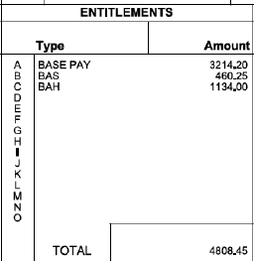
This is the Entitlements block on the LES.
Notes:
This is your base pay/drill pay, allowances, or pay incentive. Make sure that you are receiving the correct entitlements. This is where you can check if you are getting pay too much or too little for your grade or for what you are getting paid for. Should not be being paid 3,214.20 for a UTA 4 drill. Or Vise versa.
Slide Time: 2 Min
Frequently asked questions-
What if I am getting paid too much?
What if I am getting paid too little?
Why do I not get BAS and BAH for drill?

Slide 8
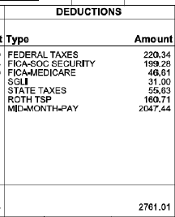
This is the Deductions block on your LES.
When your unit does not have drill, the SGLI, Dental, Tricare, ect will get taken out the next month you drill. For example, the SGLI payment may be $62 instead of the usual $31.
Notes:
This will show what was taken out of your pay for state and federal taxes, SGLI, FICA, TSP, Dependent dental. Make sure the correct deductions are being taken out. You may also see on there that you may have a debt. You can learn what that debt is usually at the bottom in the remarks section. Some cases your unit ADMIN will have to call the PFO for clarification for the debt.
Slide Time: 3 min
Frequently asked questions-
Q: How do I find out what the debt amount is for?
A: You will have to pull the print version and on the bottom of the LES in the remarks section it should tell you. If not you can talk to your Admin and they can talk to the PFO
Q: How do I change the amount taken out for TSP?
A: On the left hand side on the main My Pay page under pay changes you will see the option to click on Thrift Savings Plan (TSP). That is were you go to change the amount of money taken out for your TSP.

Slide 9
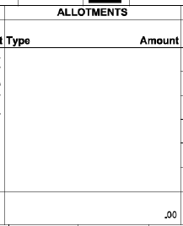
This is the allotment box on your LES.
Notes:
An allotment is a designated amount of money that is automatically distributed for you, from your pay. Be sure you know what they are, who is receiving them, and if/when will they be paid in full. Reserve and National Guard do not have allotments. Army Emergency Relief, Privatized Housing, Government Indebtedness, Child Support, etc. This is in a different section because it is different from your drill pay or base pay that you receive.
Slide Time: 2 min
Frequently asked questions-
Q: How do I know if I am getting the right amount in allotments?
A: You can check with your Admin and if you are not getting the allotments you are supposed to, your Admin can help you fill out the paperwork that the PFO needs to correct it.

Slide 10
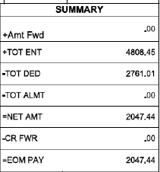
The summary box on your LES. Giver you a break down of the other three boxes.
Notes:
The Summary section includes the total of all entitlements, deductions and allotments. The End of Month (EOM) Pay is the amount to be paid. Check to ensure that all the numbers are added correctly.
Slide Time: 2 Min
Frequently asked questions-
Q: What if the totals are wrong?
A: Tell your Admin and they will get it sorted with the PFO.
Q: What if the total is not what I got paid?
A: The Admin will call the PFO and see if there was a mixup and correct it if need be.

Slide 11

This is the small box under the summary box on your LES.
Notes:
DIEMS stands for your date of initial entry to military service. Make sure that this date is correct because it determines your years of service box sand that can change your pay due to how long you have been in the military. Ret PLAN box is the type of retirement plan you are on. For M-Day the ret plan box is blank.
Slide time: 3 Min
Frequently asked questions-
Q: What if the RET plan box is empty?
A: M-Day retirement box is empty. If you are AGR, ADOS, or Tech should have something in that box. If not talk to your admin.
Q: What if my initial entry to military service is wrong?
A: The Admin can submit the change or error to the PFO.

Slide 12
This is the Federal tax section on your LES. All the boxes determine how much of federal taxes is being taken out.
Notes:
This has your wage period, wage year to date, marital status, multiple jobs, dependents, additional tax, other income and tax year to date. Make sure that your marital status is correct as they factor into your withholding amount. This is why it is important to check your My Pay and to notify your ADMIN if you have marital status changes.
Slide Time: 2 Min
Frequently asked questions-
Q: What if there is information that is wrong in my tax blocks?
A: let your Admin know.
Q: How do I get info changed or fixed?
A: Your Admin will work with you to fix the info to the correct information.

Slide 13
The FICA tax box. This is located under your federal tax boxes.
Notes:
The Federal Insurance Contributions Act (FICA) contains information on Social Security and Medicare Taxes withheld.
Slide Time: 2 Min
Frequently asked questions-
Q: Do I get any of this when I file my taxes?
A: You will get some of this back when you file.

Slide 14

Your State tax information is located next to your FICA taxes.
Notes:
These boxes contain what state taxes are being taken out, the wage period, the wage year to date , your marital status, tax exemptions, and taxes year to date. Check to make sure that your State, marital status, and exemptions are correct as they factor into your withholding amounts.
Slide Time: 2 Min
Frequently asked questions-
Q: I thought guard doesn’t have to pay state taxes?
A: You will get back all the state taxes you pay back when you file.
Q: What if I am getting taxes taken out in the wrong state?
A: Let your Admin know and they will have you fill out a DA 2058 that will be submitted to the PFO along with a screenshot of you’re My Pay with the state tax code on it.
Q: Does the state go off where you live or when your unit is?
A: it goes off where you live.

Slide 15
The pay data box has other indications that show what factors into your pay.
Notes:
The Pay Data section includes information associated with your housing allowances. It is labeled as Basic Allowance for Quarters (BAQ) or Basic Allowance for Housing (BAH). The type and dependent is based on your dependency status. The Variable Housing Allowance (VHA) Zip is used to vary your BAH rate based on your location. The Joint Travel Regulation (JTR) is a location code used to calculate Cost of Living Allowance (COLA) and 2D JTFR is the code for your dependent’s location. If you made a donation through an Allotment, it will appear in the Charity Year-to-Date (YTD) field. The PACIDN is the Unit Identification Code (UIC). The Training Program Code (TPC) is used by the Reserve and National Guard.
Slide Time: 2 Min
Frequently asked questions-
Q: What if any of the information is wrong?
A: Let your Admin know and they will work with you to get the information changed.

Slide 16

This section of boxes is your Retirement plan info. Depending on what you set your TSP up as determines where your info will go.
Notes:
This Soldier has their TSP contributes going into a ROTH and not the traditional. That is why the traditional is blank. The Thrift Savings Plan (TSP) section is broken out by Traditional and Roth TSP contributions. Any changes to TSP contributions and updated address will be made on https://mypay.dfas.mil/. If you are under the Blended Retirement System, you will see the Service Automatic and Matching Contributions in this section. The TSP Year-to-Date (YTD)total amount of contributions will include tax deferred and tax exempt amounts. Check your TSP amount under my account at TSP.gov to make sure the numbers on your LES Match.
Slide Time: 2 Min
Frequently asked questions-
Q: How do I change my TSP?
A: On the left hand side on the main My Pay page under pay changes you will see the option to click on Thrift Savings Plan (TSP). That is were you go to change the amount of money taken out for your TSP.
Q: What if I am not getting the matching the gov said they would?
A: they slowly start increasing the matching as you are in the military but after two years if you are not getting the 5% match, let your Admin know and they will talk to the PFO.

Slide 17
These blocks show you how much leave you have and how much you have used within that fiscal year through the pay period.
Notes:
Brough-forward balance (BF Bal) what you brought over from the prior fiscal year. Ernd- the lease you earned in the fiscal year. Used- is how much you used during the current fiscal year. CR bal- is your current balance through the pay period. ETS balance- balance through end of ETS. Use/ lose tells you how much you have to use or you will lose before the next fiscal year. You can only carry 60 leave days over.
Slide Time: 2 Min
Frequently asked questions-
What do I do if I am M-day and have leave?
How do I use my leave or sell it?
Q: Can I transfer my leave to new orders that I am on?
A: You will fill out the 4187 with your Admin and they will submit that to the PFO to transfer your leave to knew orders. It would be the same process to sell your leave as well.

Slide 18
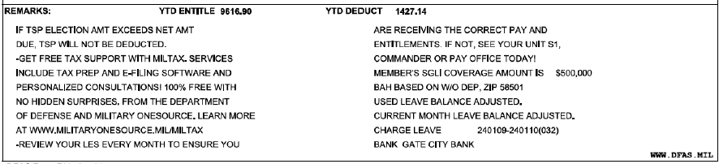
The final part of the LES is the remarks section.
Notes:
This part of the LES fills in some blanks that are not covered in op boxes. In tis section it will tell you what days of IDT pay you are getting paid for. It will tell you what debts, if you have any, what they are for. Tells you what your SGLI is set at and other helpful information in there for you to use. This is remarks from an AGR LES and look different from those that are seen on an M-Day LES. When having pay issues, always look at your LES first to see that that says before reaching out to your Unit ADMIN. Their first question will always be what did your LES say. Make sure to remind your Soldier’s that they are the only ones that have access to their my pay account. They are the only ones that will know if they are having pay issues. It is very important that they know what to look for.
Slide Time 4 Min
Frequently asked questions-
Q: What if the bank info is wrong?
A: You will have to log into you’re my Pay account and on the left hand side under pay changes, click on Direct Deposit. That is where you will find your bank info and where you change it. Remember it takes 5-7 business days to change so make sure you do it well before your next drill or paycheck.
Q: What if he SGLI amount needs to change?
A: If want less taken out for SGLI, you will have to log into Milconnect and change the amount of coverage you want.
Q: What if the debt reason is not in the remarks section?
A: if it is not in there, your Admin will be able to call the PFO and get the reason for the debt.

Slide 19

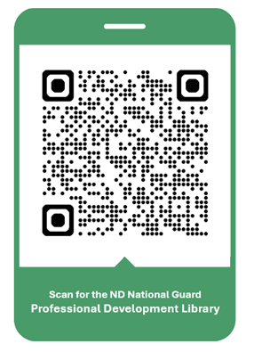
Professional Development Library
We are looking for your Professional Development Briefings!
Check out the NDNG
Professional Development Library
Submission Guidelines
(No CAC Required)
Notes:
Say: The Social Health Work Group is looking for your amazing OPD/NCOPD briefings. The submission process is outlined by scanning this QR Code. Additionally, scanning the QR code will bring you to our already published OPD/NCOPD library. We are always looking for motivated individuals to join the efforts of the Social Health Work Group. Please contact Amy Ruff, R3SP (amy.l.ruff4.civ@army.mil or 701-333-3804) if you are interested. Please bookmark or favorite this URL location for your future reference. Let's move on to our AAR.
Slide Time: 30 seconds
Notes: This slide must remain in Professional Development Library publications.

Slide 20
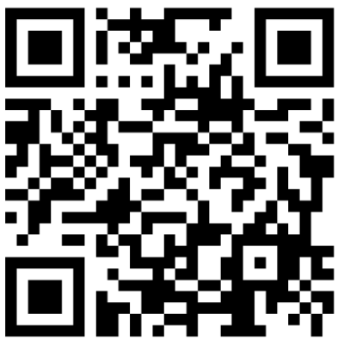
Professional Development Library
After Action Review (AAR)
Estimated Time: 2-3 Minutes
Scan for the AAR
https://forms.osi.apps.mil/r/4kDP2WDSvM
Notes:
Say: The Social Health Work Group will utilize this AAR to help improve the OPD/NCOPD course, as well as gain your ideas for future course development. It should take two to three minutes to complete.
Slide Time: 2-3 Minutes
Notes: This slide must remain in Professional Development Library publications. If the course presenter or unit leadership would like copies of the AAR results, they can contact Amy Ruff, R3SP at amy.l.ruff4.civ@army.mil or 701-333-3804.

Slide 21
ANY QUESTIONS?
Notes:
Most questions should have been asked during the presentation. Most remaining questions may be pay related, and the ADMIN NCO should be able to answer most or know who to contact at the pay office to solve the problem.

