Slide 1
Controlled Unclassified Information (CUI)
The use of leadership skills advances unit cohesion, resilience and readiness
LEADERSHIP MATTERS
MyTeam-MyGuard
PEOPLE FIRST
MISSION ALWAYS
MyTeam-MyGuard is an education and mentoring program for servant leaders which utilizes core leadership competencies to increase team building, unit cohesion, a trusting culture, personal resilience and unit readiness.
CUI
Notes:
Say: The MyTeam-MyGuard Front Line Leader Development is an action plan supported by the Social Health Work Group which is one of five work groups overseen by the NDARNG’s Commander’s Ready and Resilience Council. The goal of the action plan is to create a menu of training briefs for Officer/NCO professional development.
Slide Time: 30 seconds
NOTES: To remain within the anticipated 30-minute time frame, it is important to stick to the slide times as indicated, however, if you have flexibility in time feel free to extend the discussions and practical exercises.

Slide 2
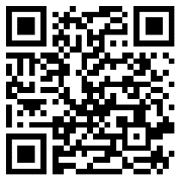
LEADERSHIP MATTERS
Interpersonal Communication skills
LEARNING OBJECTIVE
Action
Improve skill and confidence in communicating and interacting with our fellow Soldiers.
Standard
Demonstrate the effective use of communication skills.
Notes:
Say: The Social Health Work Group wants to ensure quality instruction and we ask that you scan in and complete this survey; it will take less then 60 seconds.
Say: Today we will focus on technics and strategies to be able to communicate effectively in all situations.
Ask: Have you ever tried to have a hard conversation with a Soldier and did not know how to have it? Have you ever felt like the conversations you have with your Soldiers seem not to be effective.
NOTE: The above question is rhetorical question; acknowledge the nodding heads.
Say: The skills and technics we are going to review will provide understand on what it take to be able to have effective conversations with our Soldiers.
NOTE: There are five survey questions for the pre-test
Slide Time: 1 minute

Slide 3
Comfortable with Being Uncomfortable
MyTeam-MyGuard
People First Mission Always
Social Health Work Group
Being a leader means that YOU will have to talk and/or counsel soldiers about situations that you WILL feel uncomfortable about
Situations that you may face include
  Suicidal Ideation or Self Harm
  Counseling Negative or Positive
  DUI/MIPs
  Financial Concerns
  Domestic Abuse
  Sexual Assault
CUI
Notes:
Say: It isn’t “fun” to talk to people about the consequences of their decisions or the consequences of their inactions. As leaders we need to be able to have these difficult conversations with confidence.
Say: It is easy to fumble around when you are uncomfortable. Sometimes our fear comes out when we’re talking to soldiers about these situations. We need to be aware of our own feelings about different situations.
Say: Having strong communication skills and knowing your Soldiers with a foundation of trust will make difficult conversations easier and more effective.
Slide time: 1 Minute

Slide 4
MyTeam-MyGuard
People First Mission Always
Social Health Work Group
Overview
Getting Back to Basics
  What is communication?
  Types of communication
Getting Personal
  Trust
  Mindful Communication
CUI
Notes:
Say: Today we discus what communication is and the different types. We will also discuss the importance of building trust with our Soldiers and importance of mindful communication.
Trainer note: trainers will be expected to share their own examples. There may be examples given in the materials, but the trainer is highly encouraged to think of examples ahead of time from their personal experience. Personal experiences are considered more genuine and sharing is part of the interpersonal communication.
Slide Time: 30 Seconds

Slide 5
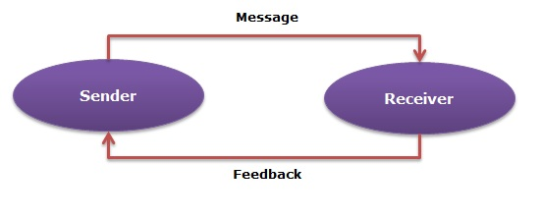
What is Communication?
MyTeam-MyGuard
People First Mission Always
Social Health Work Group
Communication is simply the act of transferring information from one place, person or group to another.
Every communication involves (at least) one sender, a message and a recipient.
CUI
Notes:
Say: With this lesson, we’re getting back to basics. Starting from scratch with communication.
Say: Communication is simply the act of transferring information from one place, person or group to another.
Say: The image in this slide is a great display of closed loop communication. Closed loop communication is when the communication process is completed by the receiver of a message acknowledging receipt of the message by sending feedback back to the sender. Closed loop communication is important for effective communication in any situation.
Slide time: 45 Seconds

Slide 6
What is Communication?
MyTeam-MyGuard
People First Mission Always
Social Health Work Group
Listening
Smelling
Touching
Tasting
Speaking
Seeing
CUI
Notes:
Say: It is important to know that communication is not listening and speaking. Communication comes in many forms to include listening, smelling, touching, tasting, speaking and seeing.
Slide time: 15 Seconds

Slide 7
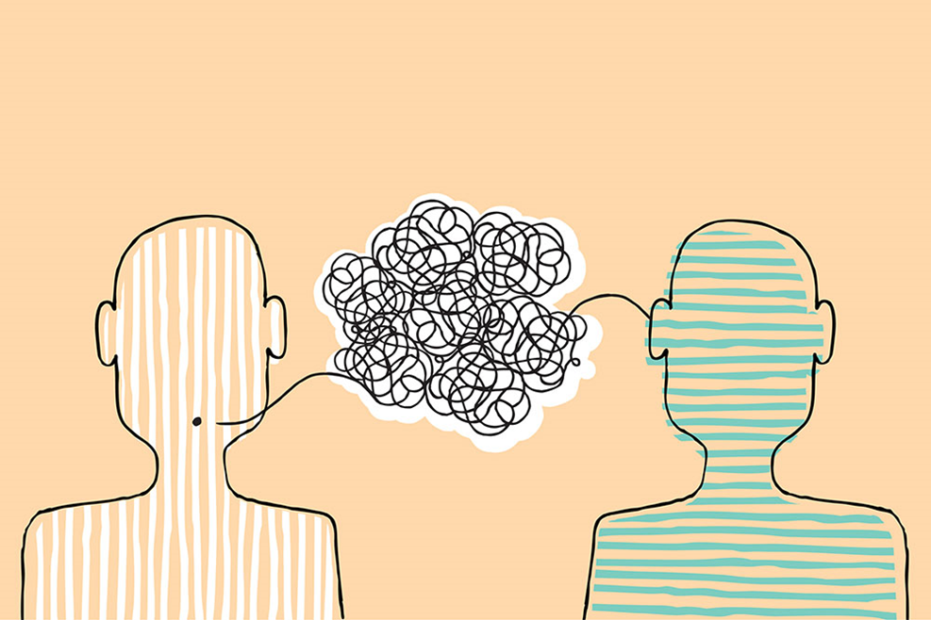
4 Types of Communication
MyTeam-MyGuard
People First Mission Always
Social Health Work Group
Written
Non-Verbal
Verbal
Listening
CUI
Notes:
Say: We will discus following four types of communication in more depth. Written, Non-Verbal, Verbal, and Listening.
Slide time: 15 Seconds

Slide 8
Written Communication
MyTeam-MyGuard
People First Mission Always
Social Health Work Group
Written communication is any written message that two or more people exchange.
  More formal but less efficient than verbal communication
Examples include
  Blog posts, text message, emails, reports, counceling
Mixed or Conflicting Messages
CUI
Notes:
Say: Within written communication, there can be mixed messages. In the military, it seems like our email communication is more short and to the point. However, when it is a change from what the other person is used to, there can be a potential for mixed or conflicting messages to occur. What are mixed or conflicting messages? Mixed messages are communications that send conflicting information. They can occur in written and verbal communication. Some examples of written mixed messages include when punctuation does not reflect the statement.
Say: Counseling’s are considered a formal form written communication but should always involve verbal communication along with the counseling.
Ask: What are some examples of conflicting or mixed messages in written communication that maybe you’ve had?
(Encourage the group to share their own examples of when they’ve had to clarify an email or other written communication.)
(Instruct can share their own example if they have one)
Slide time: 2 Minutes

Slide 9

Non-Verbal Communication
MyTeam-MyGuard
People First Mission Always
Social Health Work Group
Body Language
  UCLA Study report that 55% of communication is passed non-verbally
Even if you can’t read people’s minds, you can read their body language and facial expressions.
CUI
Notes:
Say: Body language place a significate part in our ability to communicate effectively. As you see on the slide studies show that over 50% of our communication is passed non-verbally. We need to be conscious of our body language when we are having conversations.
Slide time: 30 Seconds

Slide 10

Body Language
MyTeam-MyGuard
People First Mission Always
Social Health Work Group
Best practices
  Things to do
    Open Posture
    Mirroring
  Things to avoid
    Crossed arms
    Fidgeting
Personal Space
CUI
Notes:
Say: Body language uses posture and gesture to communicate. In the image we see examples of different body language from the same person in the say situation.
Ask: How would you describe the body language of the person in each image?
Ask the group: how do we show that we’re interested by our body language? Can anybody model that for us? Praise the group; transition into talking about open posture. Open posture is the posture that somebody wants when they want to convey to the other person an interest and willingness to listen. Model open posture: hands are apart, arms resting in the lap or arms of the chair. Trainer: now look to see if any participants are following your guidance on open posture. If so, point it out and transition onto the next point: mirroring. Mirroring is simply copying the other person’s body language; it is something that we unconsciously do when we feel a bond with the other person. It’s a sign that the conversation is going well and you or the other party is receptive to the information.
Say: When communicating to our Soldiers it is important we present ourselves in a way to for effective communication. We want to have good eye contact. Have an open posture and ensure we are reading the body language from the person we are talking to. One body language cues that you might notice during a conversation is a face of confusion. This would indicate that clarification on what you are saying is required.
Say: Another good reminder is please be respectful of people’s personal space. Some people don’t like their personal bubble to be breached. If you have to and it may involve touching the other person, please ask them first. “Can I step behind your desk to show you how to fix this excel spreadsheet?”
Slide time 2.5 minutes

Slide 11
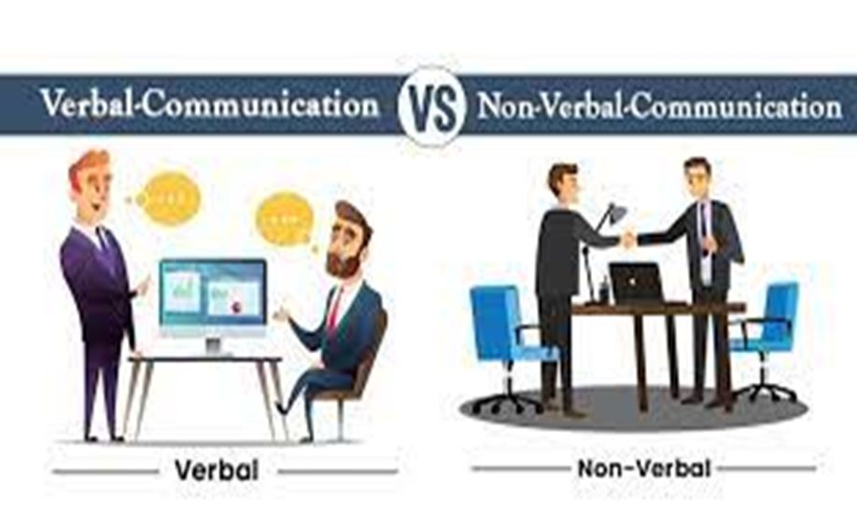
Verbal Communication
MyTeam-MyGuard
People First Mission Always
Social Health Work Group
Components of Verbal Communication
I Statements
Effective Verbal Communication
CUI
Notes:
Say: It’s time to discuss verbal communication. We’re going to learn the components of verbal communication, such as para-verbal messages, I statements and effective verbal communication.
Slide time: 15 Seconds

Slide 12

Verbal Communication
MyTeam-MyGuard
People First Mission Always
Social Health Work Group
Components of Verbal Communication
  Messages – the words we choose
  Para verbal Messages – how we say the words
  Nonverbal Messages – our body language
CUI
Notes:
Say: Notice how nonverbal messages is a component of verbal communication. It is all connected, the message that we send to the receiver.
Say: In this section, we’re going to focus on the words that we chose and the para-verbal messaging, which is how we say the words that we chose.
Slide time: 15 Seconds

Slide 13
Verbal Communication
MyTeam-MyGuard
People First Mission Always
Social Health Work Group
Para-verbal Messages
  Tone, pitch, pacing
“I didn’t SAY you were not listening.”
“I didn’t say YOU were not listening.”
“I didn’t say you were not LISTENING.”
CUI
Notes:
Say: The way we say things can modifying the meaning of the sentence even when we use the excate same words. Tone, pictch and pace all matter when we are verbally communicating.
Discuss: Emphasizing different words in the same sentence. Ask what their perception of each sentence. Point out the differences that people comment on.
Slide time: 1 Minute

Slide 14
Verbal Communication
MyTeam-MyGuard
People First Mission Always
Social Health Work Group
I Statements
  “I feel…” must be followed with an emotion word, such as angry, hurt or worried
  Use a soft and even tone
  Describe how the person’s actions affect you
Example
  Blaming: “You never take out the trash. I guess I’ll just do it all the time.”
  I Statement: “I feel hurt when you don’t help out with the trash. I’m afraid that you’re going to stop helping with other things around the house.”
CUI
Notes:
Say: Next we’re going to talk about I statements and how to express concern, appropriately and effectively through verbal communication.
Say: I statements are a simple way of communicating without being blamed. When a person feels like they’re being blamed, they become defensive, and communication can shut down. Once somebody becomes defensive in a conversation, it is hard for them to switch their thinking. Our role is not to blame but to share concern.
Slide time: 1 Minute.

Slide 15
Verbal Communication
MyTeam-MyGuard
People First Mission Always
Social Health Work Group
Effective verbal communication best practices
  Knowledge: be knowledgeable about communication
  Timing: choose an appropriate and adequate time
  Mindful: pay attention to circumstances
  Listen: actively, empathically, with the goal of being loving rather than ‘right’
  Be honest—say what you mean
CUI
Notes:
Say: Knowledge, timing, being mindful—keep these in mind. If you know that somebody’s having an awful day, more than likely, it’s not the best day to sit down and talk to them about the group project that they have not been working on.
Optional: Trainer can feel free to use an example in their own life of verbal communication best practice—what has worked well? Were there times that it didn’t go well? (Can pull from family and personal life)
Slide time: 1 Minute

Slide 16
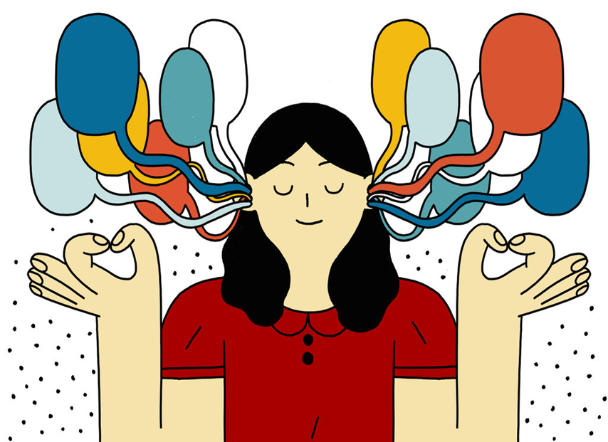
Listening
MyTeam-MyGuard
People First Mission Always
Social Health Work Group
  Listening vs Hearing
  Active vs Passive
  Good & Bad Listeners
  Reflective Listening
CUI
Notes:
Say: Now we will discuss our final form of communication, listening.
Say: Listening is hard! Listening and hearing are two different things. Hearing revolves around the physiological act of hearing sounds. We don’t have to concentrate to hear—it’s more like collecting data. On the flip side, listening is the act of actively paying attention to the words and sounds that we hear to absorb what we are hearing. It’s an active process. Remember that video? They were hearing each other but not listening to each other.
Say: Next time when you feel that somebody isn’t listening to you, it’s probably true—they are hearing you but not listening to you.
Slide time: 1 Minute

Slide 17
Listening
MyTeam-MyGuard
People First Mission Always
Social Health Work Group
Passive vs Active Listening
  Active: being engaged
  Passive: disengaged
Good & Bad Listeners
  Characteristics
Reflective Listening
  Benefits include:
    Clarification
    Increase understanding
CUI
Notes:
Say: Within listening, there are two different types of listening: active and passive.
Say: Active listening requires curiosity, motivation, purpose and effort. The active listener attempts to understand what they are hearing in order to connect with the other person and participate in a meaningful conversation. It is the way you want to listen if you want to understand or if you are looking to solve a problem with another individual. A good example of a person being an active listener is a counselor: they are engaged in the conversation and trying to understand what is happening.
Say: Passive listening is the opposite: it is listening that is disengaged, inattentive, and unreceptive. The passive listener has no desire to contribute effectively to the conversation and probably already has an opinion formed about what is happening.
Say: Let’s move onto characteristics of good and bad listeners. What are some characteristics of good listeners? How about bad listeners?
(Good Listeners: attentive, receptive, open-minded, fully engaged, etc., bad Listeners: inattentive/distracted, judgmental, close-minded, speak over you, interrupt, etc.
Say: The last component of listening that we’re going to talk about is called reflective listening. Reflective listening is where the listener tries to clarify and restate what the other person is saying. It can help increase the listener’s understanding of the situation. The benefits to reflective listening include clarifying what the other person is saying, increasing the understanding and reassuring the other person that somebody is trying to see their point of view and to help them express their thoughts.
Slide: 2 Minutes

Slide 18
Listening
MyTeam-MyGuard
People First Mission Always
Social Health Work Group
How to Practice Reflective Listening Effectively
  Don’t interrupt
  Try to remember important facts or points
  Repeat back “So what I’m hearing you say is…”
  Keep an open mind!
  Express genuine interest
  Being aware of body language, tone of voice and gestures
Be careful to avoid
  Criticizing/blaming
  Diagnosing
  Praising
CUI
Notes:
Say: reflective listening It also helps stop us from being inattentive. How many of us find ourselves thinking about what to do for supper tonight or what else is on our to do list instead of actively listening to somebody?
Say: We also want to try to give people acknowledgement responses. These are brief responses to show the other person that we are listening. Ask the group for acknowledge examples. Some acknowledgement examples include: oh wow, I’m tracking, right, ok, gotcha, etc.
Say: We also want to be careful to avoid certain traps. We don’t want to blame and make them feel foolish. A few examples of blaming type comments are: you’re out of line, that was a dumb thing to do, or that’s a stupid thing to say. Diagnosing is another one we want to avoid. We don’t want to tell somebody else the why behind their behavior—we are not trained professionals, and let’s be honest, even if we think it’s true, if they’re not open to hearing it, it makes US look foolish and closes the door to communication. Some examples of diagnosing include: you’re just angry, what you really need is, you’re being paranoid. One more surprising thing to avoid is praise. Usually these comments end up as condescending, such as you usually have good judgement, you have so much potential…those don’t quite sound like praise, do they?
Say: This is not an all encompassing list of what to do or what not to do. Some of this is trial an error. We were not born great listeners but it is a skill that we’ve had to develop over time. What we also want everybody to know is that none of us are perfect and some conversations go better than others. But what’s important is that you KEEP trying and notice that pattern of what went well and what did not go well.
Slide time: 2 minutes

Slide 19
Getting Personal
MyTeam-MyGuard
People First Mission Always
Social Health Work Group
Overview
  Trust Building
  Getting to know each other
  Mindful Communication
CUI
Notes:
Say: In this section, we’re going more in-depth about getting personal with each other.
Say: Let’s talk a little about the why we’re talking about this. Previous focus groups and URIs have indicated a lack of trust in leadership by their soldiers. This has been an identified issue and we are here to chip away at it, one soldier at a time.
Slide time: 30 Seconds

Slide 20
Trust Building
MyTeam-MyGuard
People First Mission Always
Social Health Work Group
“To be trusted is a greater compliment than being loved.” –George MacDonald
What is trust?
  A set of behaviors
  A set of behaviors such as acting in ways that depend on another
  Belief in a probability that a person will behave in certain ways
  Feeling of CONFIDENCE and security
What trust isn’t…Absolute. It IS situational.
CUI
Notes:
Say: George MacDonald, famous author, commented once that to be trusted is a greater compliment than being loved. We all know that for a relationship to work, you need trust.
Say: Let’s put that in terms of a working relationship. To be an effective team, you have to have trust. Trust isn’t just knowing that Soldier Snuffy is qualified with the M4, but it’s also having trust that if there are issues, Soldier Snuffy will come to their supervisor and discuss them. Why is this important? Well, if Soldier Snuffy is distracted, or having thoughts to hurt themselves. We want Soldier Snuffy to have enough trust that he can communicate this to his leadership.
Ask: How do we get to that point that our Soldiers will come to us? (Ask the group for suggestions and examples.)
Ask: Ask yourselves if you have trust in your leadership.
(Rhetorical question they should not answer this question out loud)
Say: Trust is not absolute. It is situational. A good example of this is trusting our partners. Think about what you trust your partner with and how you may not also trust your partner. Would you trust your partner with surgery? Unless they are a doctor, probably not.
Slide time: 2 minutes

Slide 21
Mistrust/Lack of Trust
MyTeam-MyGuard
People First Mission Always
Social Health Work Group
Mistrust
  Lack of confidence
Lack of Trust
  Development of harmful thoughts
  Negative attributions
CUI
Notes:
Say: To talk about trust building, we also need to briefly discuss mistrust and lack of trust. Mistrust is a lack of confidence in something. Maybe you mistrust the judicial process. Lack of trust is what happens when we question the other person’s activities, words, or actions.
Say: When a lack of trust occurs, it allows for the negative emotional process to start—the development of harmful thoughts, suspicion or negative attributions. Ever heard somebody say that they think their split form or hardship form was denied because their leadership does not like them? That’s lack of trust.
Slide time: 1 minute

Slide 22
Getting to Know Your People
MyTeam-MyGuard
People First Mission Always
Social Health Work Group
How do you get to know somebody?
  What kind of questions can you ask?
Benefits
  Forbes Article: Your Job Satisfaction May Have More To Do With Who You Work With Than What You Do (2020)
    2019: Employee stress rose 20% over three decades; 35% respondents identified direct bosses
    People might find their job interesting but still hate it. Why? SOCIAL EXPERIENCE
    When people feel valued, they are motivated to do their very BEST
  TRUST
CUI
Notes:
Say: You need to take a genuine interest in your soldiers. People know if you’re not being genuine. It can be tough to remember all their kids names or even where they work, but if you have a general idea that Soldier Snuffy has 3 girls, school age, an easy and quick question can be—how old are your kids now? When do they start school? And carry the conversation on there. By doing that, you are taking an interest in who they are outside the uniform. You are helping to build those social connections that can be a protective factor in people’s lives.
Say: Why do we do this? What are the benefits of getting to know our people?
Say: Let’s talk about the 2020 Forbes Article. The Forbes article discussed the findings that even if people found their job interesting, they can still hate it due to the social experiences. Supervisors are part of that social experience. The article also shares about how when employees feel valued, they are significantly more likely to report they are motivated to do their very best for their employer.
Say: What does that mean for the military when people are motivated to do their very best? What benefits could arise from people doing their best? Discuss retention as a benefit and how retention helps the military.
Say: One benefit of getting to know your people is trust. We need to be able to trust that somebody has our back and will fight, advocate for us when we need it. When we need an advocate, whether it’s due to witnessing behavior unbecoming to a soldier, such as sexual harassment or assault, we need to make sure that even the E3 knows that they can step in and advocate for the O5 if it is needed. We all need to engage at times, regardless of rank.
Slide time: 2 Minutes

Slide 23
Connection
MyTeam-MyGuard
People First Mission Always
Social Health Work Group
What is a leader?
What is a friend?
Setting Boundaries
  Saying “no”
  Saying “yes”
  Asking for help
  Showing gratitude
  Being kind to ourselves & others
“As a leader, you are always going to get a combination of two things: What you create and what you allow.”
-Henry Cloud
CUI
Notes:
Ask participants: what is a leader? Is a leader the same thing as a boss? Has there been a leader that has inspired you?
Ask participants: what is a friend? Can a leader be a friend?
Say: People can be both, but they have to draw boundaries. Boundaries define what is ok and what is not ok; Forbes describes boundaries as a “fence.” Boundaries are not always happy white picket fences; it can be difficult to set but boundaries actually help us create trust. People know what kind of interaction that they will receive, and they don’t have to wonder if they went too far.
Say: Some suggestions on setting boundaries include saying no, saying yes, showing gratitude, asking for help and being kind to ourselves and others. Asking for help isn’t a sign of weakness: it creates an atmosphere where people feel valued for their work and assistance These boundaries help create an atmosphere of positivity and satisfaction which in turn, increase motivation for the work place.
Slide time: 2 Minutes

Slide 24
Mindful Communication
MyTeam-MyGuard
People First Mission Always
Social Health Work Group
What is Mindfulness?
  According to Jon Kabat Zinn, Mindfulness is “The awareness that arises from paying attention, on purpose, in the present moment and non-judgmentally”
  The act of slowing down and noticing can actually make us more effective and efficient
Mindlessness is the opposite: going for a walk while looking at our phone, getting lost in our thoughts and not remembering what we are doing, watching TV while eating
CUI
Notes:
Say: There are many definitions of “mindfulness.” One definition is, the awareness that arises from paying attention, on purpose, in the present moment and non-judgmentally”
Say: Mindlessness is the opposite…it’s not paying attention to what we are doing...getting lost in thoughts…why did I just walk in my pantry…what was I just doing…walking while being on our cell phones.
Ask: Why is mindfulness important when communicating?
Slide time: 1 Minute

Slide 25
Mindful Communication
MyTeam-MyGuard
People First Mission Always
Social Health Work Group
Bringing awareness to the way we communicate with others
    Helps us from shutting down
    Helps us to learn that silence can be a useful and good tool
How do we start?
  Pay attention!
CUI
Notes:
Say: Bringing mindfulness—essentially awareness—to the way we communicate has several benefits. Being aware of our feelings and emotions can help stop us from shutting down during important conversations with leaders and families.
Say: Pay attention to the way you communicate. Do you typically shut down during conversations with your supervisor? What are you feeling during this time? When we open up emotionally, it’s because we feel safe with that person. Safe from judgement, safe to share our thoughts without fear of the other person laughing. Having the courage to be vulnerable.
Say: We’ve all had those conversations that go poorly at times. Think back to a conversation that you’ve had at one point that you shut down and refused to engage. Maybe it was a fight with a spouse. Maybe it was during a constructive criticism session or hotwash.
Slide time: 1 minute

Slide 26
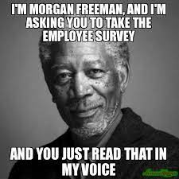
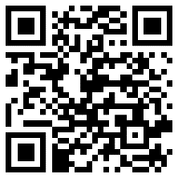
Interpersonal Skills Post-Test
MyTeam-MyGuard
People First Mission Always
Social Health Work Group
Image reproduced from memeshappen.com
CUI
Notes:
Say: Thank you for your time and participation as we learned about Interpersonal communication. Is there any questions or further discussion for the good of the group?
Say: Please take the next 60 seconds and fill out this post-test; it will help the Social Health Work Group to ensure you are receiving a quality instruction..
NOTE: There are 8 questions on the post test
Slide Time: 1 minute

